Slide 1
GNED140
WEEK 11 Canada’s Food Guide, Food Labels, Healthy Eating, Nutrition For Sports
Professor: Abdul Yusuf, Fall 2018

Slide 2





Portion Control (serving sizes)
Meat (3oz) = deck of cards
Fish = check book
Fruit = fist
Veggies = fist
Grain products = computer mouse
Fat = 1 dice

Slide 3
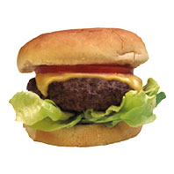
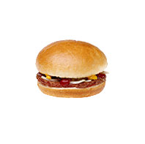
A normal size cheeseburger is approximately 333 calories.
A fast-food chain restaurant cheeseburger is approximately 590 calories
Calorie difference = 257 calories
In order to burn off those excess calories, you would have to lift weights for nearly 1 hour 30 minutes

Slide 4


2 really small size pepperoni pizza is 500 calories
2 large slices is approx. 850 calories
Calorie difference = 350 calories
Golfing for one hour (remember to walk and carry your golf bag) will burn those extra calories

Slide 5

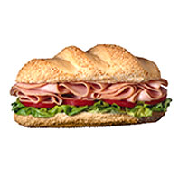
Turkey sandwich is about 320 calories
Restaurant turkey sandwich is about 820 calories
Calorie difference = 500 calories
Get on your bike for an hour and 25 minutes to burn those 500 calories

Slide 6


8 ounces coffee with whole milk and sugar is 45 calories
12 ounces coffee with steamed whole milk and mocha
syrup is 350 calories
Calorie difference = 305 calories
Walk for 1 hour and 20 minutes to burn those extra calories

Slide 7


55 calories for a chocolate chip cookie (1 ½ inch diameter)
275 calories for a fast food chocolate chip cookie
Calorie difference = 200 calories
Wash your car for 1 hour and 15 minutes and burn those extra calories

Slide 8
Canada’s Food Guide
Recommended number of servings for each group in Food Guide
Eat a variety of foods from the four food groups each day
Grain Products
3 – 8 servings
Low in fat rich in complex carbohydrates, dietary fibre, and many vitamins
Examples of single serving (slice of bread, ½ cup of rice or pasta)
Recommended choose foods low in fat or sugar
Maximum nutrition choose at least half servings from whole grains
(eg. Brown rice, whole wheat pasta)

Slide 9
Canada’s Food Guide
Fruit and Vegetables
Recommended 4 – 10 servings
Rich in carbohydrates, dietary fibre, Vitamin A, and Vitamin C
Low in Fat and sodium
Vary in nutrients so advised consume variety for healthy diet
Balanced diet recommended choose one serving from: dark green vegetables, deep yellow and orange, legumes, starchy vegetables,

Slide 10
Canada’s Food Guide
Dairy and Alternatives
Recommended 2 – 4 servings
High protein, carbohydrates, riboflavin, and Vitamin D
Limit fat best choose servings low fat or non-fat
Examples single serving (one cup milk, 50 g block cheese)

Slide 11
Canada’s Food Guide
Meat and Alternatives
Recommended 2-3 servings
Total amount servings equivalent 150- 300 g cooked lean meat, poultry, fish a day
Source protein, niacin, iron, vitamin B6, Zinc, Thiamin
Limit intake of fat, choose lean meats
Example of serving : 2 eggs, ¼ cup nuts, ½ cup meat (75 ml)

Slide 12
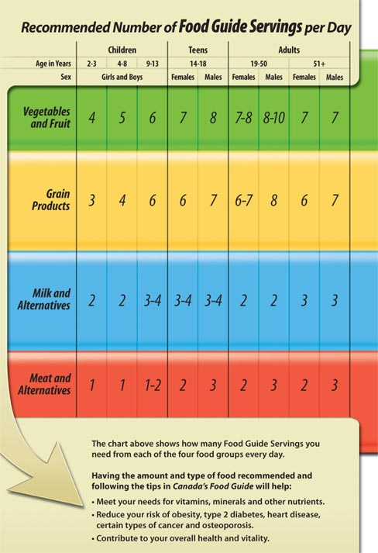
Canada’s Food Guide

Slide 13
Canada’s Food Guide
Vegetarian
- Wide variety of plan proteins since incomplete
Grain Products 5-12 servings
Fruit and Vegetables 5 - 10 servings
Milk and Alternatives 0- 4 servings
Dry Beans, Nuts, Seeds, Eggs, Meat Substitutes 2 – 3 servings

Slide 14
The Vegetarian Alternative
Types of vegetarian diets
Vegan = vegetarian who eats no animal products
Lacto-vegetarian = vegetarian who includes milk and cheese products in the diet
Lacto-ovo-vegetarian = vegetarian who includes milk and cheese products and eggs in the diet
Partial vegetarian, semivegetarian, or pescovegetarian = vegetarian who includes eggs, dairy products, and small amounts of poultry and seafood in the diet

Slide 15
Vegetarian Diets and Health
Vegetarian diets are lower in saturated fat and cholesterol and higher in complex carbohydrates, fibre, folate, vitamins C and E, carotenoids, and phytochemicals
Nutrients of concern for vegetarians include vitamin B-12, vitamin D, calcium, iron, and zinc

Slide 16
Recommended Food Guide Servings
http://www.hc-sc.gc.ca/fn-an/food-guide-aliment/index-eng.php

Slide 17
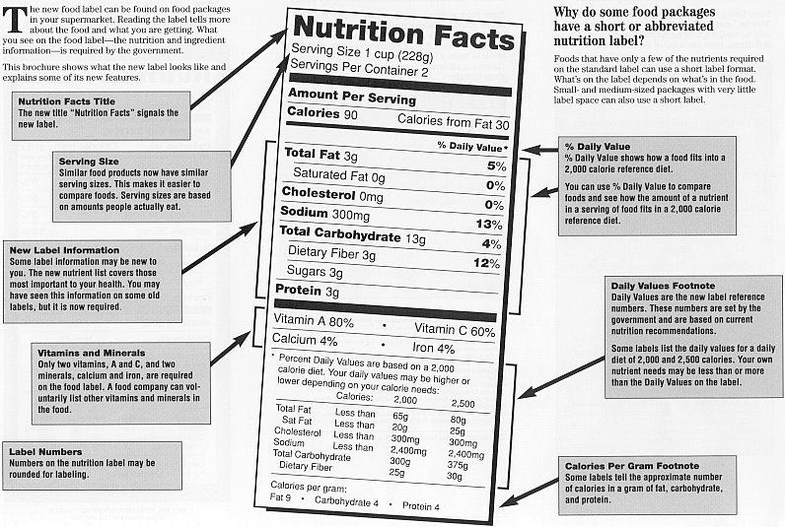
Food Labels

Slide 18
Food Labels
Canadian Food Inspection Guidelines
List nutrient content by weight
Information based on 2000 calorie diet (percentage)
Includes following:
Serving size
How many servings in package and compare to amount you actually eat

Slide 19
Food Labels
2. Calories and Calorie from fat
Total amount of calories and whether serving is high calories from fat
3. Daily Values
Daily value percentage based on 2000 calorie diet
Tell you whether nutrients in serving of food contribute a lot or little to total diet
5% or less is low 20% or more high

Slide 20
Food Labels
Recommended limit fat, saturated fats, trans fat, cholesterol and sodium
Recommended find foods high in dietary fibre, Vitamin A, Vitamin C, Calcium and iron

Slide 21
Food Additives
Substances added to food for following reasons:
1) Maintain or improve nutritional quality
2) Maintain freshness
3) Help in process or preparation
4) Alter taste or appearance
Make up less 1% food
Most widely used sugar, salt, and corn syrup

Slide 22
Organic Foods
Organic = a designation applied to foods grown and produced according to strict guidelines limiting the use of pesticides, nonorganic ingredients, hormones, antibiotics, genetic engineering, irradiation, and other practices
Organic foods tend to have lower levels of pesticide residues than conventionally grown crops

Slide 23
Food Additives
Most widely used are sugar, salt, corn syrup, citric acid, baking soda, vegetable colours, mustard, pepper
Concerns about some additives:
Monosodium glutamate (MSG) causes some people to experience episodes of sweating and increased blood pressure
Sulfites cause severe reactions in some people
Check food labels

Slide 24
SMART NUTRITION
Weekly budget for food.
Meal planning for the week. Try 10 meals and rotate them.
Create your grocery list.
Avoid shopping if you’re hungry. Less willpower.
At the grocery store, shop on the outside
Read labels

Slide 25
Food Labels
Look at serving sizes. All nutrition items on the label refer to one serving. Does not include additional ingredients needed to prepare
Look at the line marked calories. Limit items where calories from fat make up more then 1/3 of the total calories
Total fat section: gives total % and breakdown of fats. Avoid foods that contain trans fats and foods with more then 20% saturated fats for daily %. Less then 60 mg. of cholesterol.
Check the cholesterol level. Avoid foods with daily value more then 20%
Salt: less then 350mg. of salt per serving. Total per day is 1,500.
Look at the sugar content: less then 5 grams of sugar per serving
Scan the lists of ingredients: listed by quantity. First few ingredients should be whole natural foods. Not a long list you can’t pronounce. if you can’t pronounce the first 5 ingredients, AVOID!
Look for good stuff. At least 2 grams of fibre per serving, 20% or more of vitamins and minerals.

Slide 26
Nutrition for Sports
Increased energy requirements if exercise regularly or vigorously
Recommended Intake:
60 -65% diet from carbohydrates
Builds and maintains glycogen stores in muscle, resulting in greater endurance
Recommended eat carbohydrates before exercise and after exercise to replenish glycogen stores

Slide 27
Nutrition for Sports
Fat
20 – 35% calories from fat
Less then 20% negatively affect performance
Protein
10 – 15 % calories from protein
1.2 – 1.7 kg protein per body weight

Slide 28
Nutrition for Sports
Carbohydrate is the main nutrient that fuels exercise of a moderate to high intensity, while fat can fuel low intensity exercise for long periods of time.
Proteins are generally used to maintain and repair body tissues, and are not normally used to power muscle activity.
Fats can function as an energy source and anti-inflammatory

Slide 29
Nutrition for Sports
Fluids
Required compensate for fluid loss during physical activity and
maximize performance
Water good choice fluid replacement events 60-90 minutes
Longer workout sports drink could be a good choice (contain carbohydrates and electrolytes provide extra energy, replace electrolytes lost in sweat)

Slide 30
Guidelines for Sports Nutrition
Hydration | Hydration important for energy Replace lost water from workout What is the best Sport Drink???
Electrolytes | Sodium & potassium Replace because lost through sweat How can you add electrolytes to your drink?
Carbohydrates | Refuel after a workout Increase amount for endurance athletes
Protein | To maintain and repair tissues 0.5g to 0.8g/lb of body weight

